Slide 1
Big Data Analysis
By: Team Back Row
Adam LeBlanc / David Elliot / Jean-Baptiste Yamindi / Matthew Groth

Slide 2
Objective
Identify public datasets available for Education, Taxes and Housing data for analysis purposes
Load these data sets into a Hadoop cluster and use any big data tool sets available to cleanse, load, an analyze the data
Present the results of this analysis and identify any interesting data trends
Some questions we hoped to answer:
What are the attributes of the areas with the highest housing prices? And the lowest?
What are the attributes of areas with the highest education rates?

Slide 3

Education Data
Description of data
Population of each school district in WA state from 2000 to 2016 from Data.WA.gov
K-12 public school enrollment in WA state from 2009 to 2013 from Data.WA.gov
Highschool dropout statistics in each county in WA state from 2012-2013 from Data.WA.gov
Zip code database from unitedstateszipcodes.org
What if anything did you need to do for loading data
It was hard to find a common key between sets of data to help join them together
Decided to just use the school district population data
Since other data being used in the group had zip code information, we used the zip code database to figure out the zip code of each school district. This was fairly accurate even though some school districts span multiple zip codes.

Slide 4

Tax Data
Description of data
Source of data
What if anything did you need to do for loading data

Slide 5
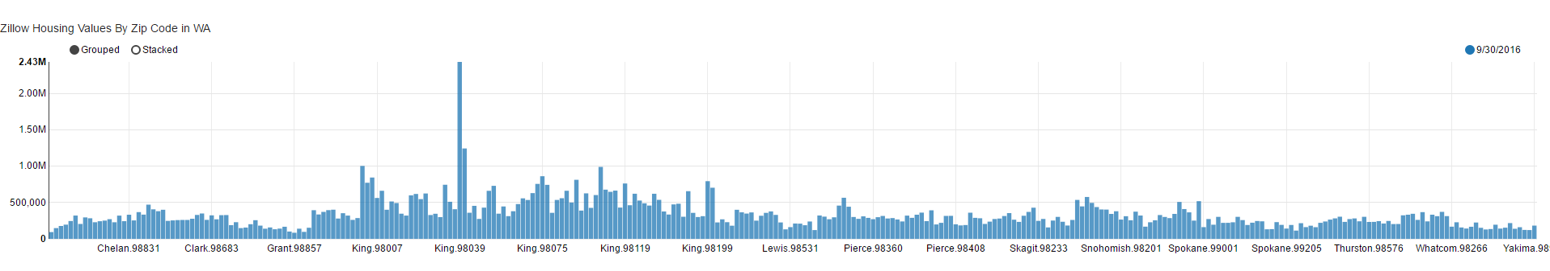

Housing Data
Pulled public data available from Zillow for average housing prices across Washington state zip codes for September 2016
http://www.zillow.com/research/data/
Data was very clean, well organized and required no validation to load into Hadoop cluster

Slide 6
Analysis & Findings

